Slide 1
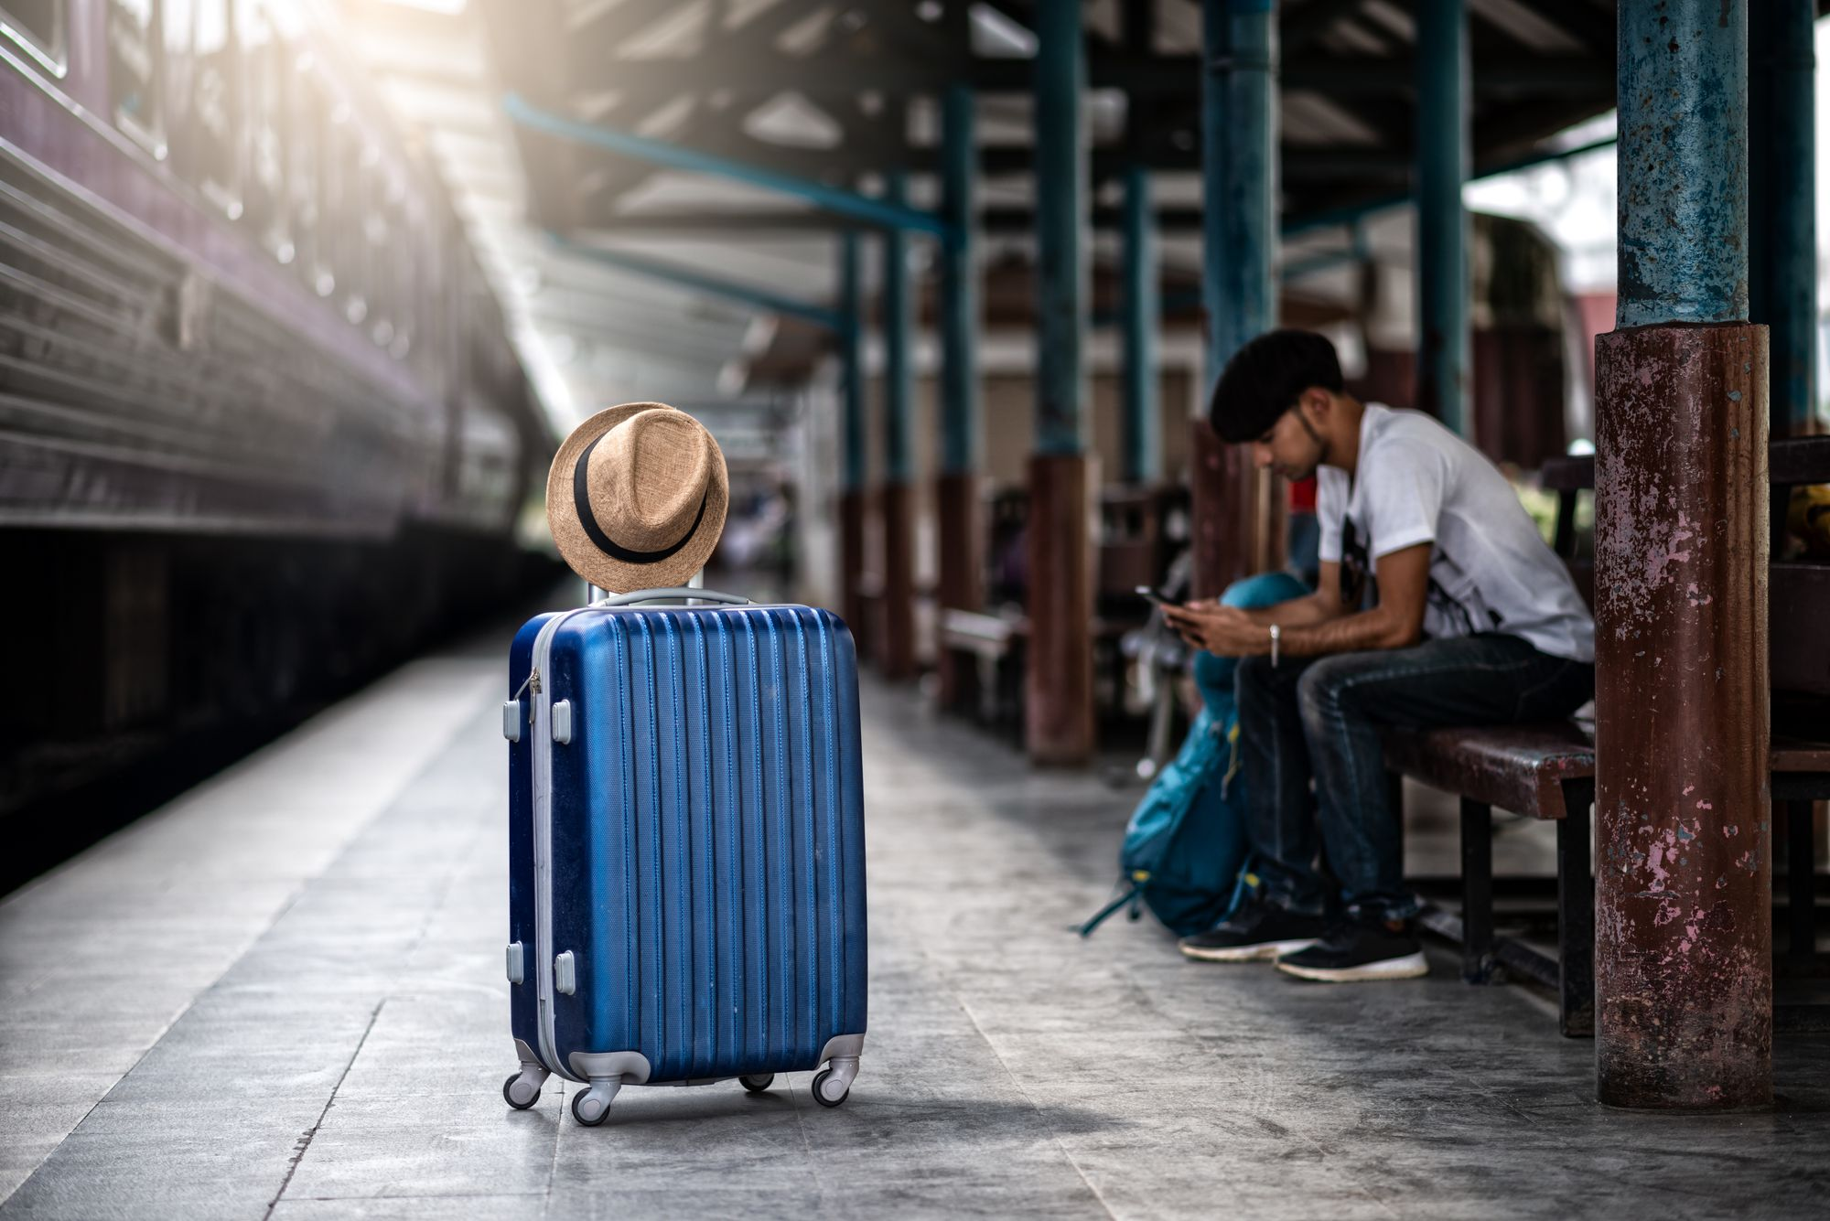
Online Train Ticket Booking System
By- Ashwini Upadhya

Slide 2
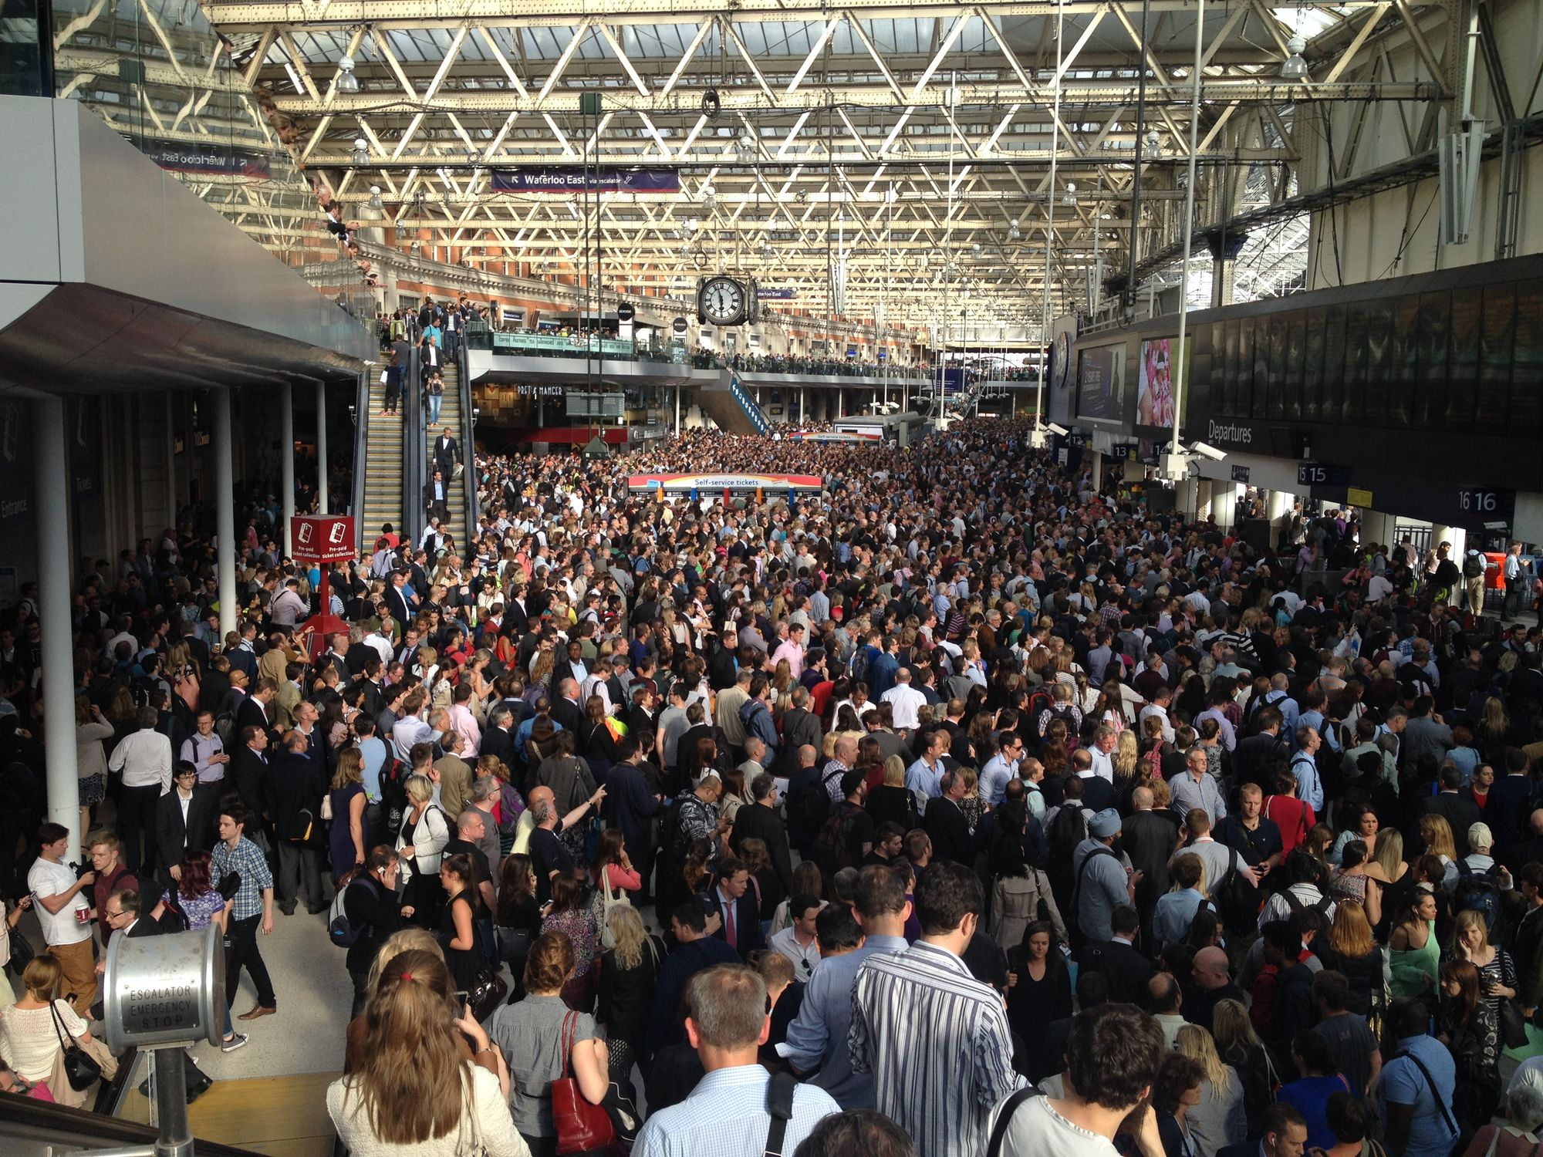
Online booking simplifies train travel for everyone involved today.
Convenient, quick, and user-friendly ticket purchasing experience.

Slide 3
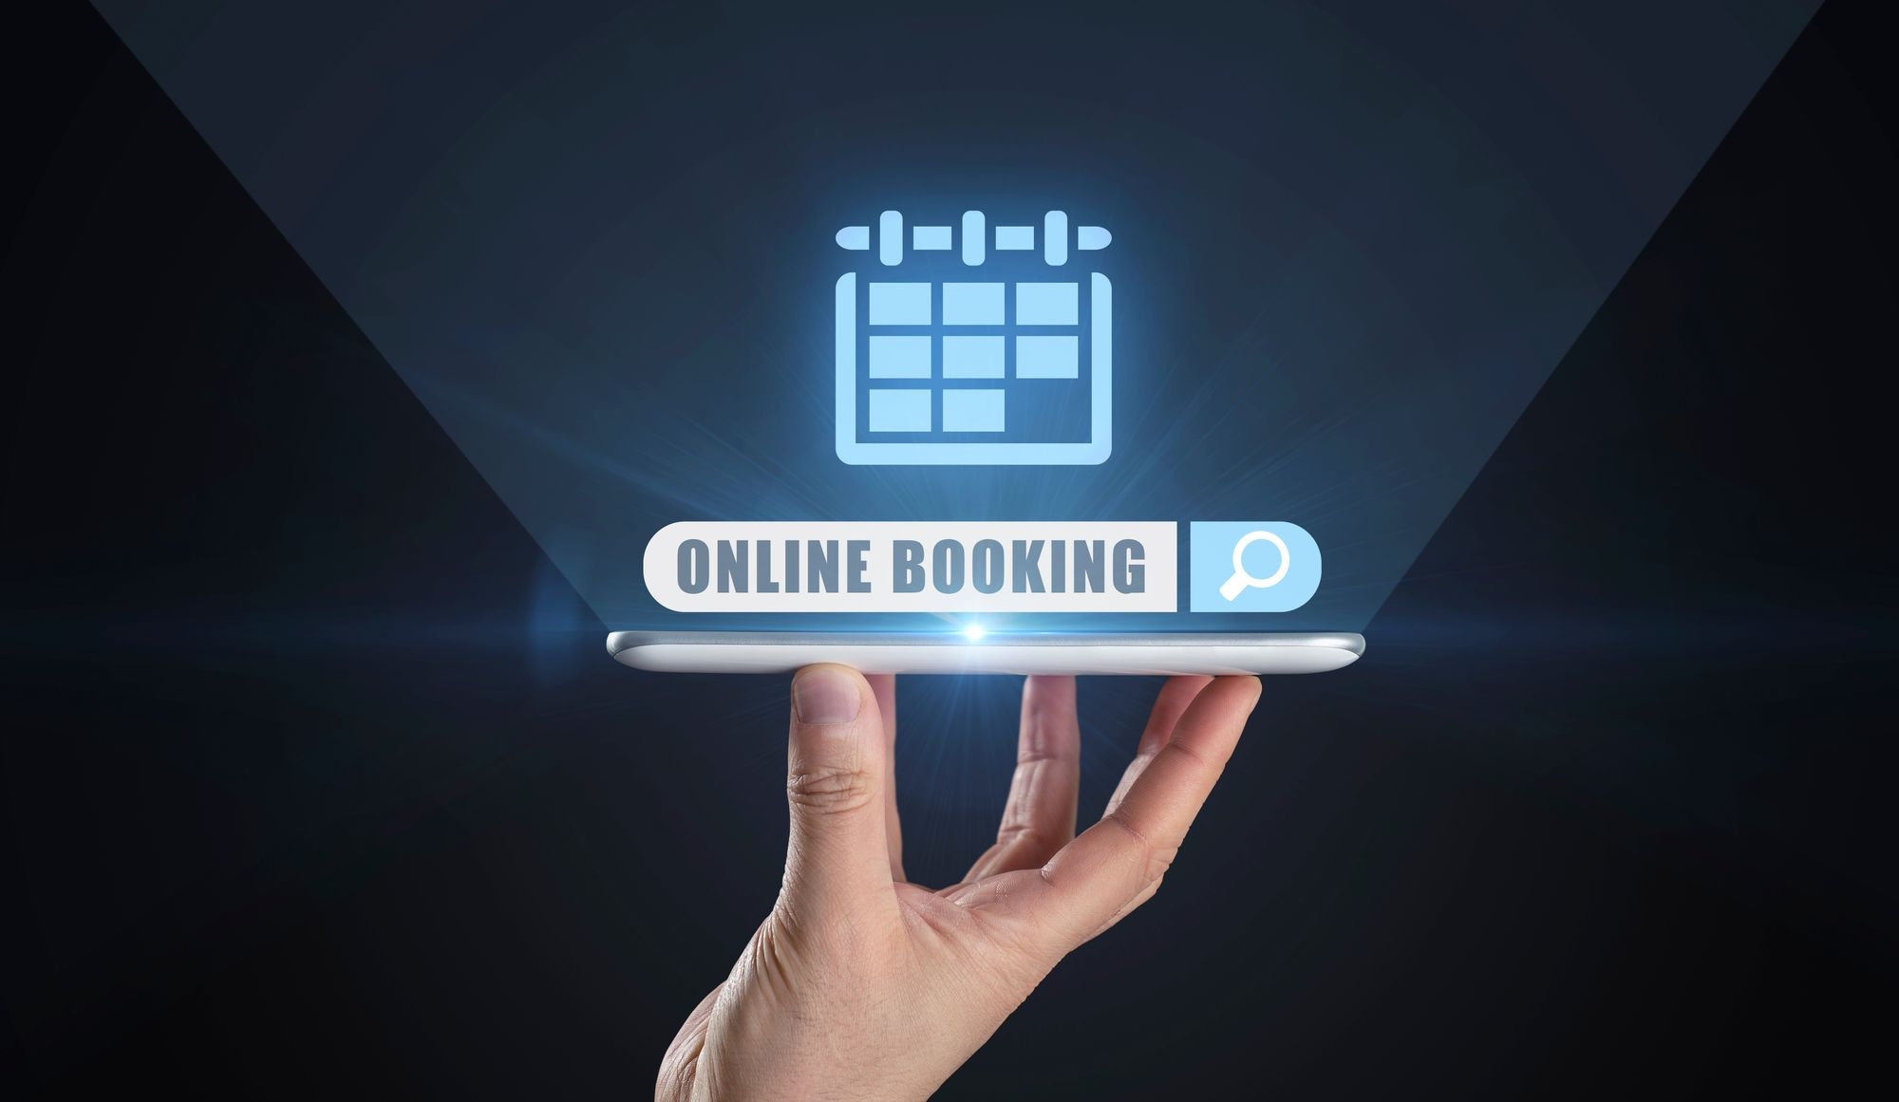
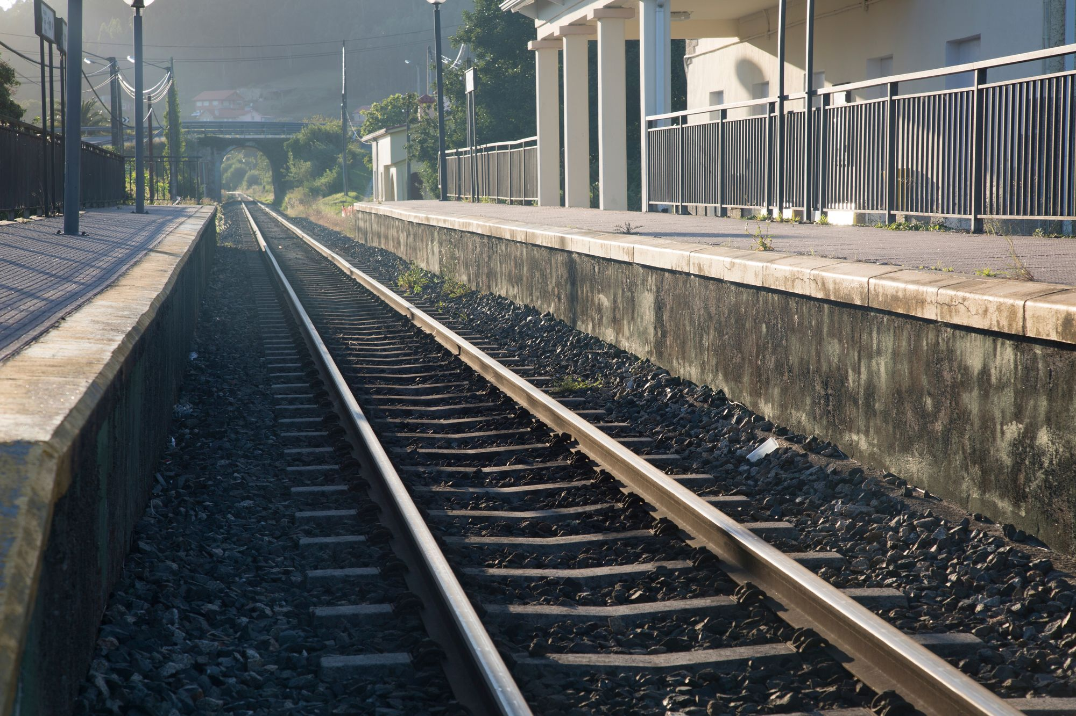

CONVENIENT TRAVEL OPTIONS
EASY ACCESS
FAST SERVICE
Ticket Booking

Slide 4

Project Scope
DESIGN AND IMPLEMENT A SQL DATABASE FOR AN ONLINE BOOKSTORE. THE DATABASE SHOULD HANDLE VARIOUS ASPECTS OF THE BOOKING SYSTEM, SUCH AS TRAIN SCHEDULES, CUSTOMER INFORMATION, TICKET BOOKINGS, AND ADMINISTRATIVE FUNCTIONS.
Scope

Slide 5
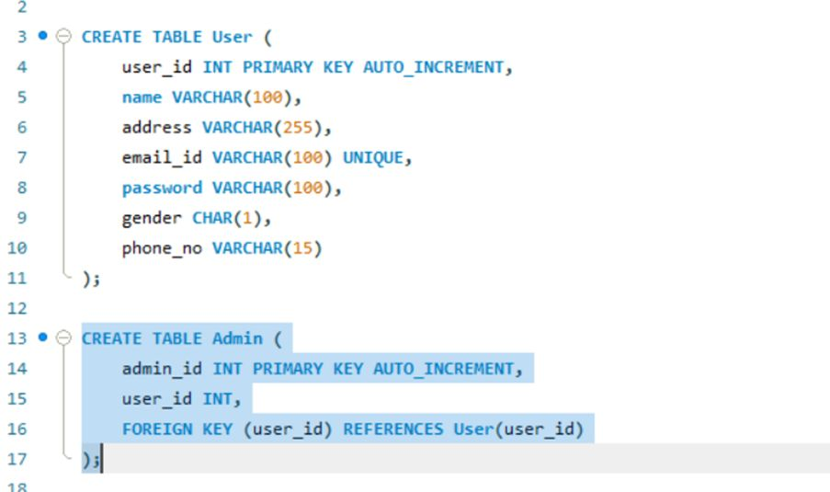
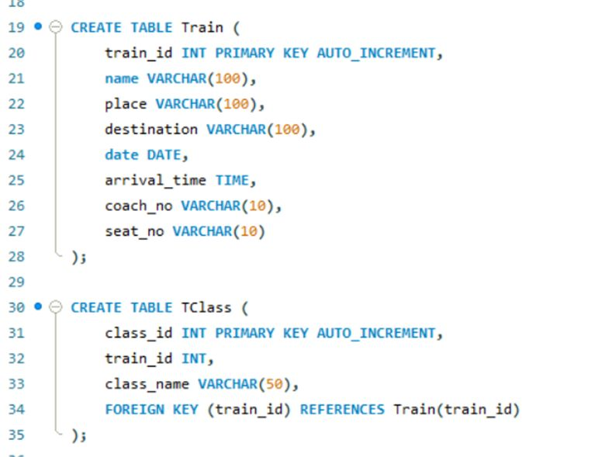
Database Design (DDL - Data Definition Language)

Slide 6
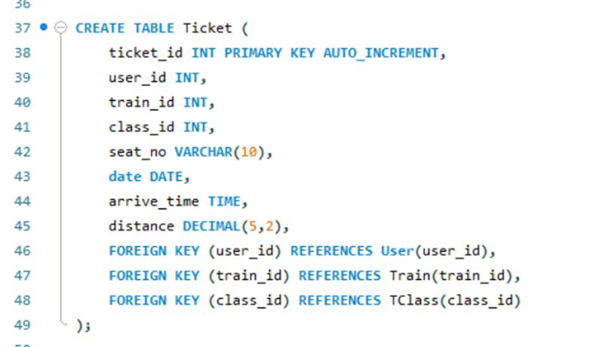
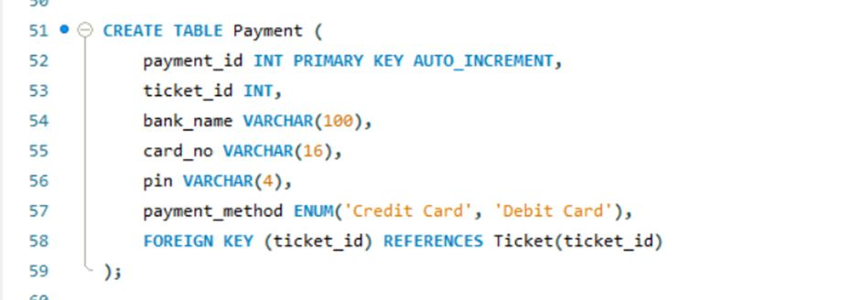
Database Design (DDL - Data Definition Language)

Slide 7
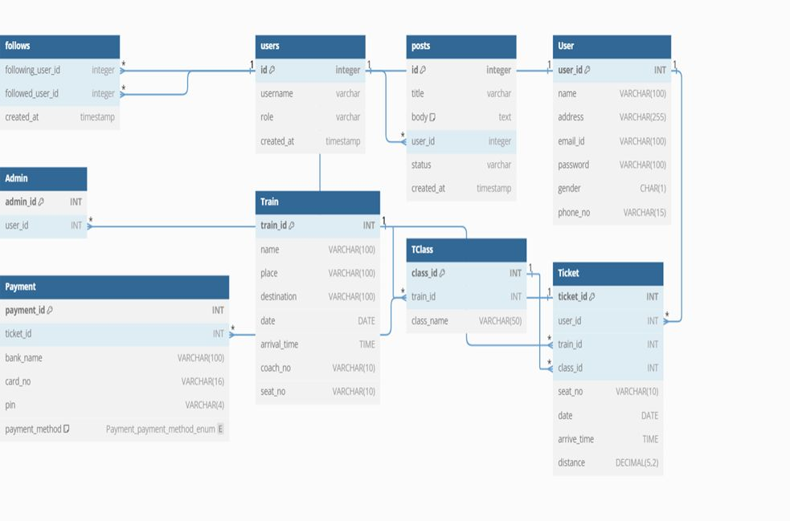
ER Diagram
This diagram visually represents the relationships between different entities (data objects) in a database system

Slide 8
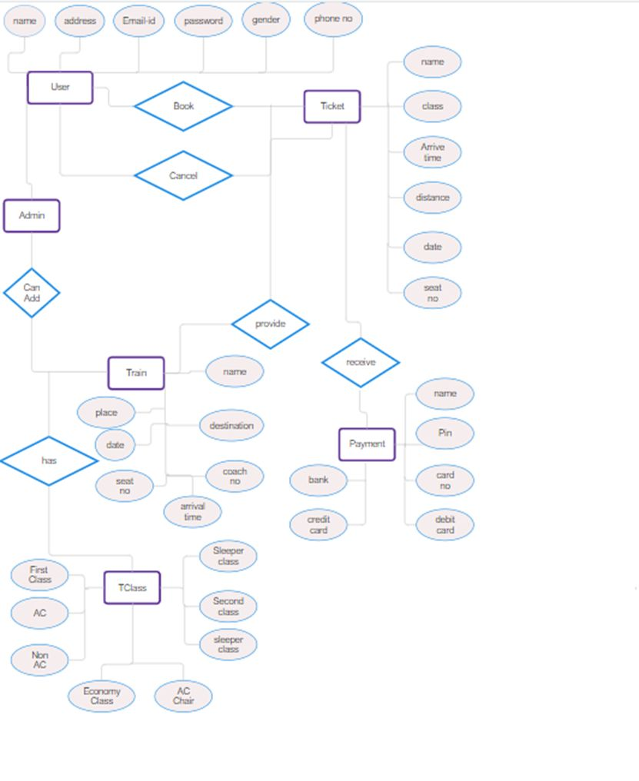
User Case Diagram
It visually represents the interactions between users (actors) and the system (use cases).

Slide 9
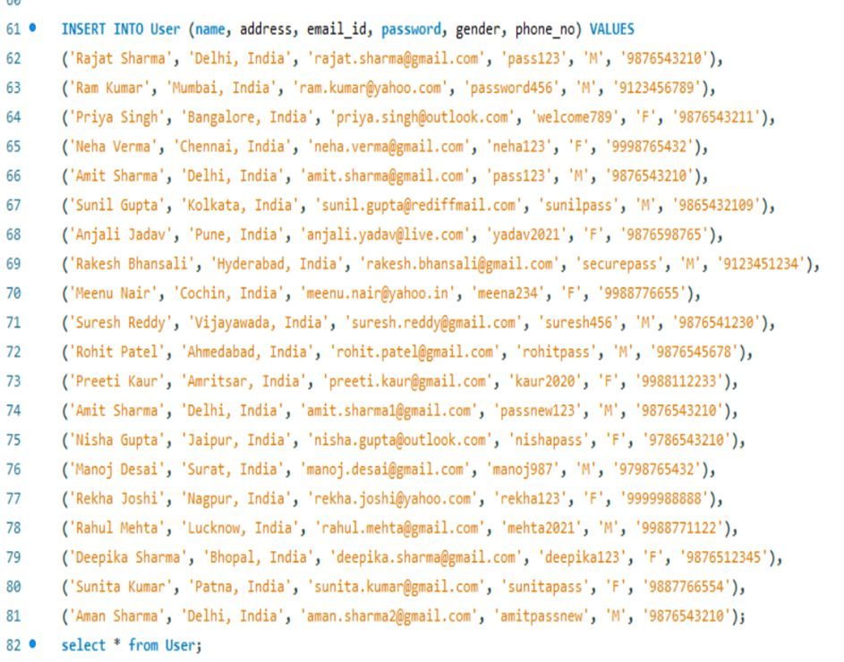
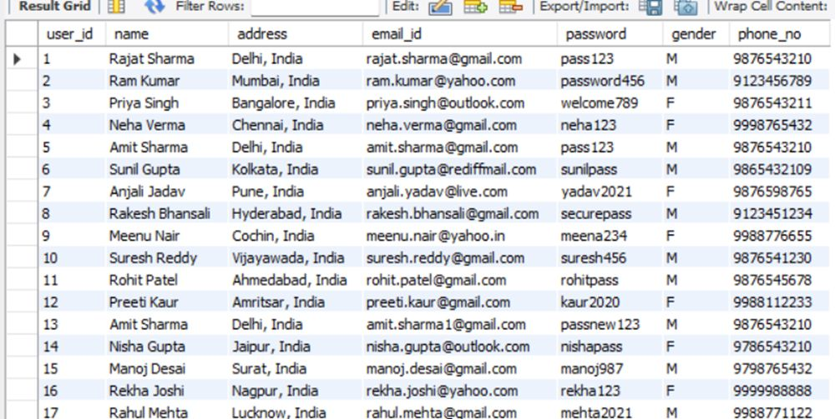
Populating Data (DML - Data Manipulation Language)

Slide 10
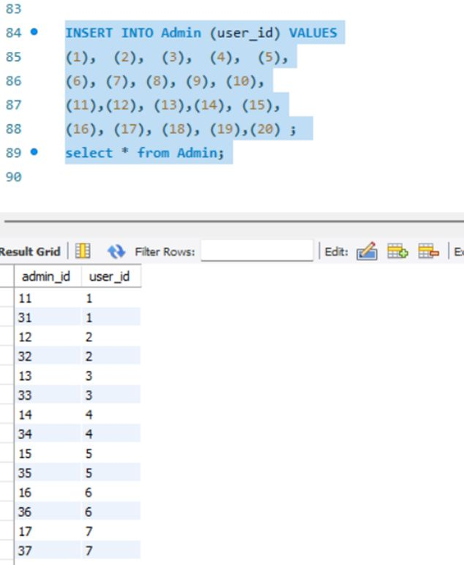
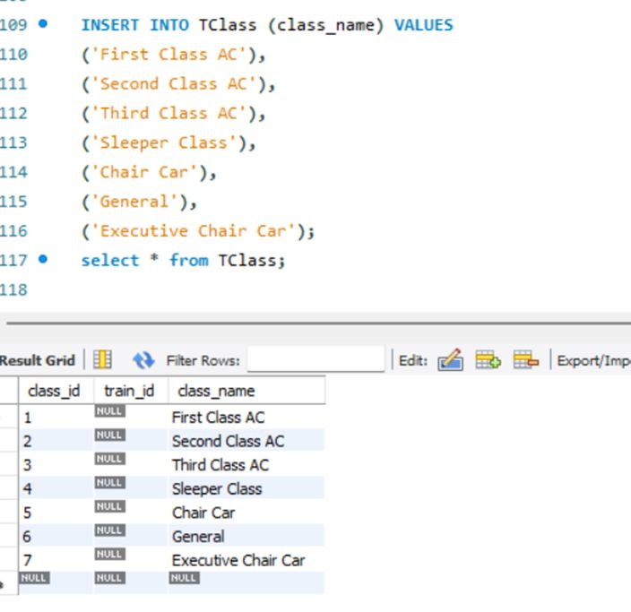
Populating Data (DML - Data Manipulation Language)

Slide 11
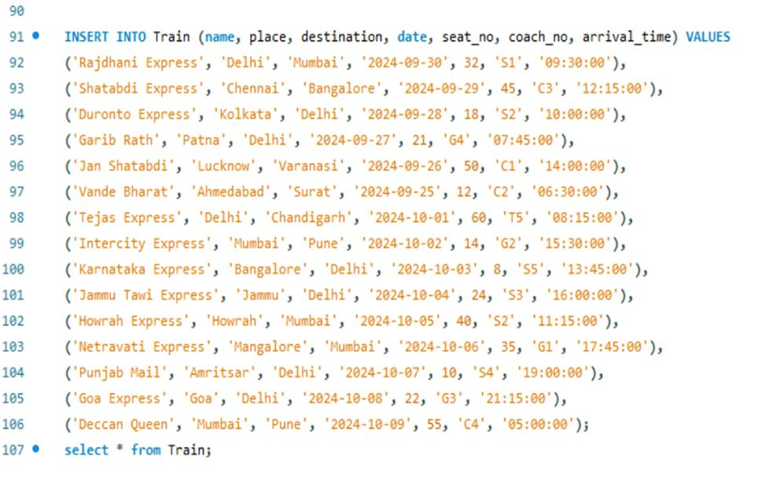
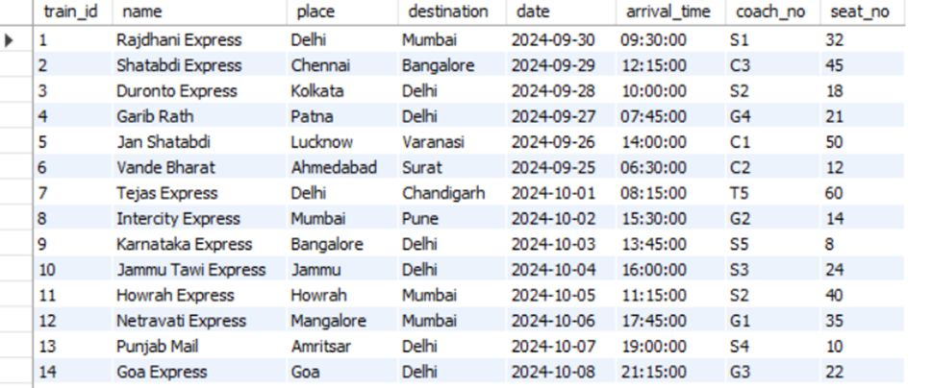
Populating Data (DML - Data Manipulation Language)

Slide 12
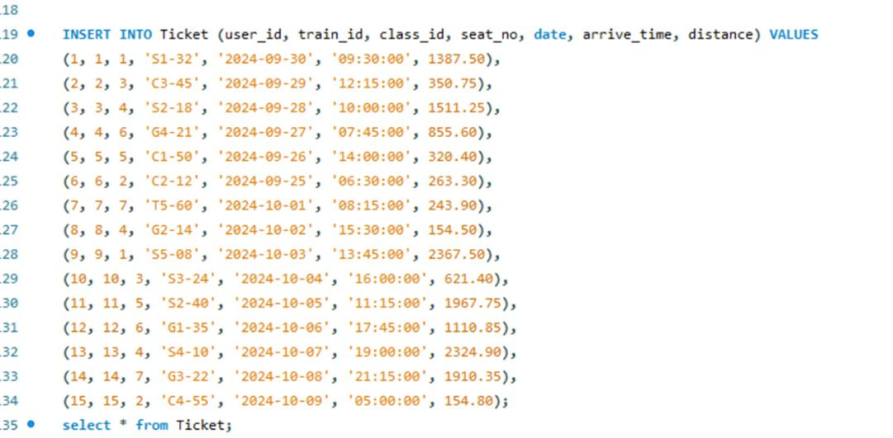
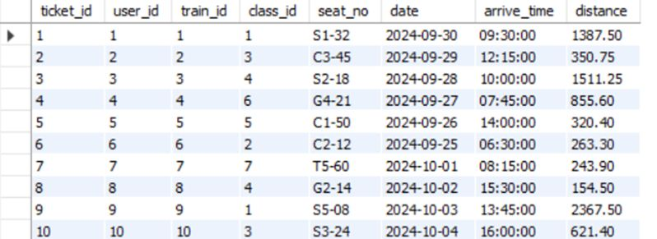
Populating Data (DML - Data Manipulation Language)

Slide 13
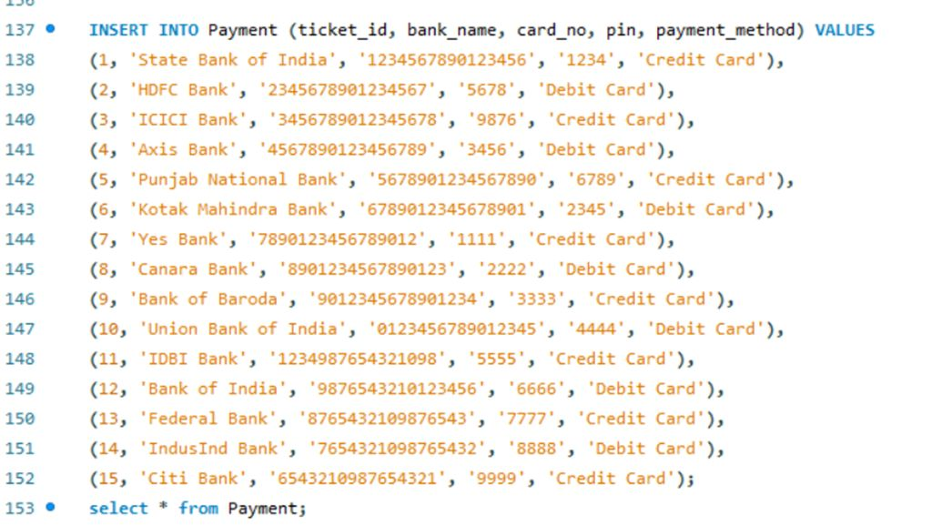
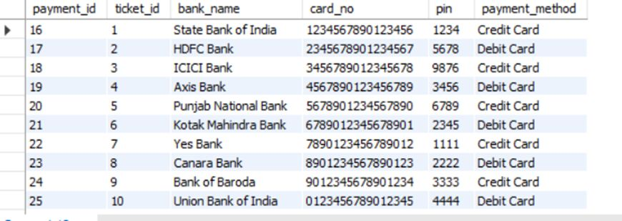
Populating Data (DML - Data Manipulation Language)

Slide 14
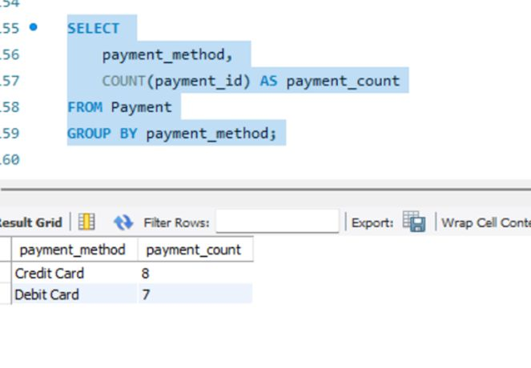
Querying Data (DQL - Data Query Language)
Count of Payments by Payment Method

Slide 15
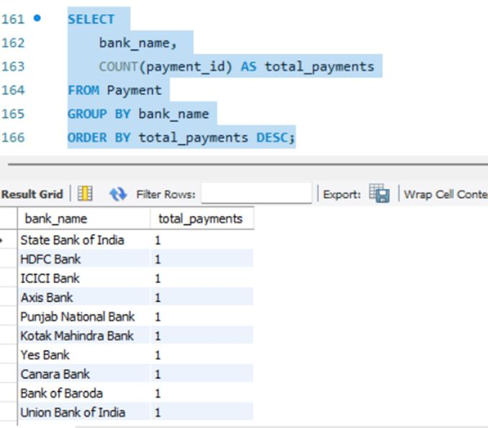
Querying Data (DQL - Data Query Language)
Total Payments by Bank

Slide 16
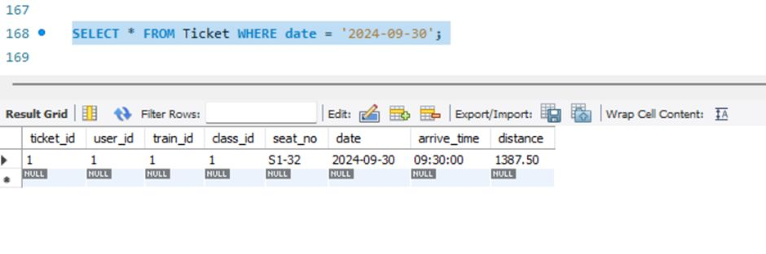
Querying Data (DQL - Data Query Language)
Retrieve Tickets for the date 30-09-2024

Slide 17
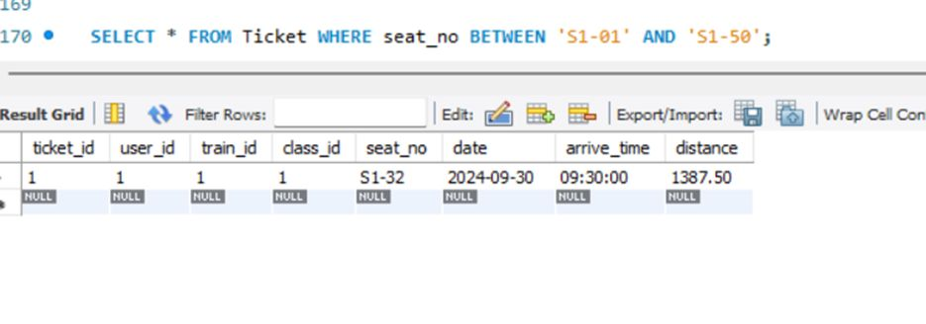
Querying Data (DQL - Data Query Language)
Find Tickets with a Seat Number in a Specific Range

Slide 18
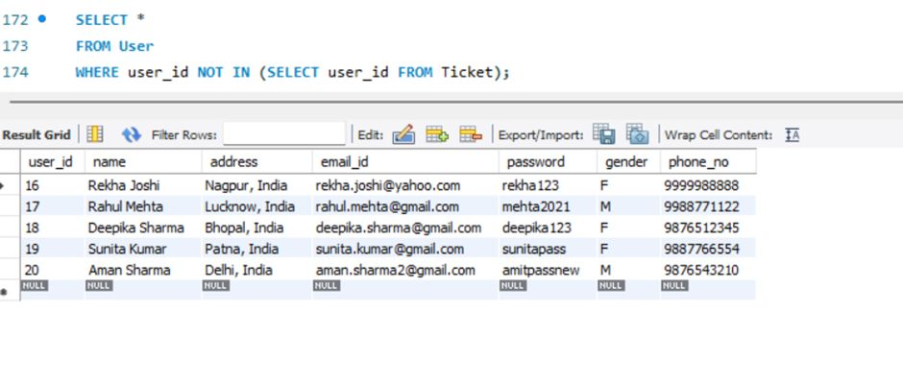
Advanced Queries and Subqueries
Find Users Without Tickets

Slide 19
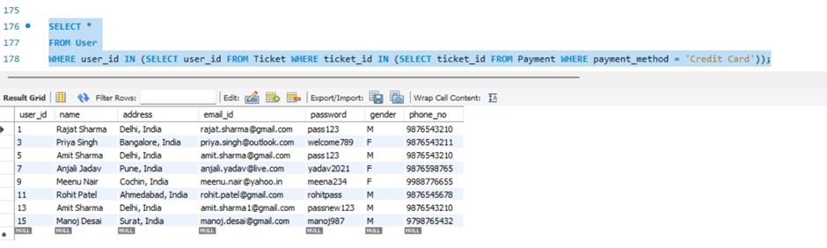
Advanced Queries and Subqueries
Find Users Who Paid Using a Credit Card

Slide 20
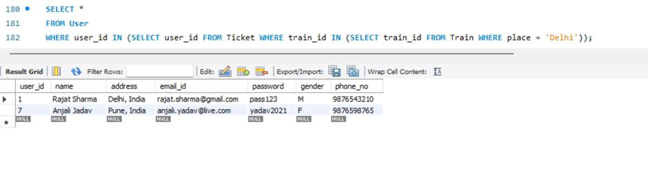
Advanced Queries and Subqueries
Find Users Who Have Taken a Train From Delhi

Slide 21
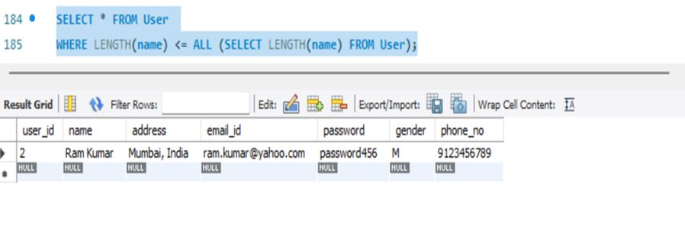
Advanced Queries and Subqueries
Find Users with the Shortest Name

Slide 22
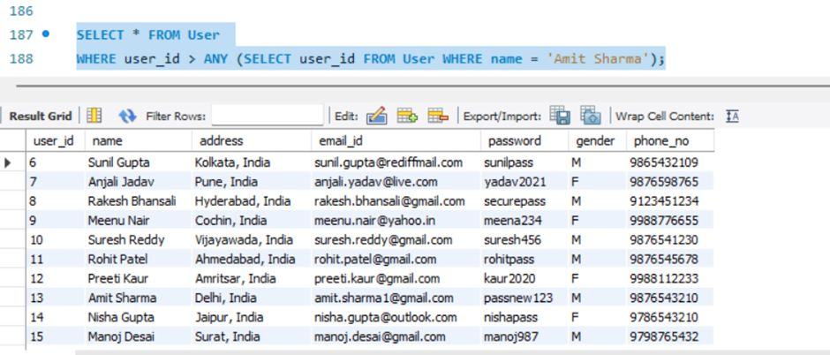
Advanced Queries and Subqueries
Find Users Whose User ID is Higher than Any User with name Amit Sharma

Slide 23
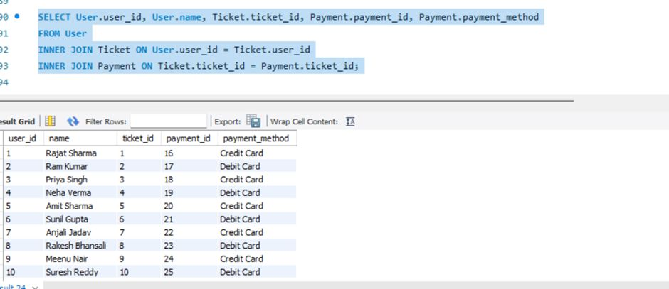
Using Joins
List Users Who Have Booked Tickets and Made Payments

Slide 24
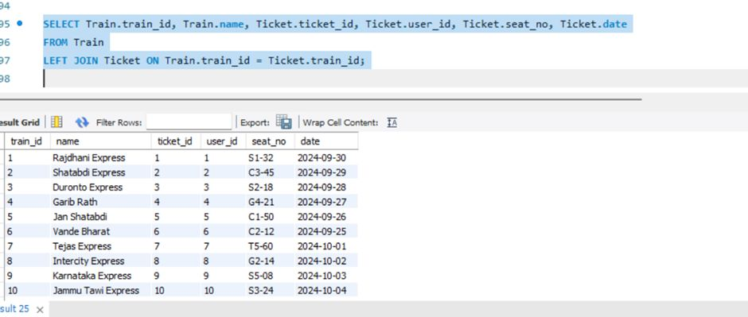
Using Joins
List All Trains and Their Tickets (Including Trains Without Tickets)

Slide 25
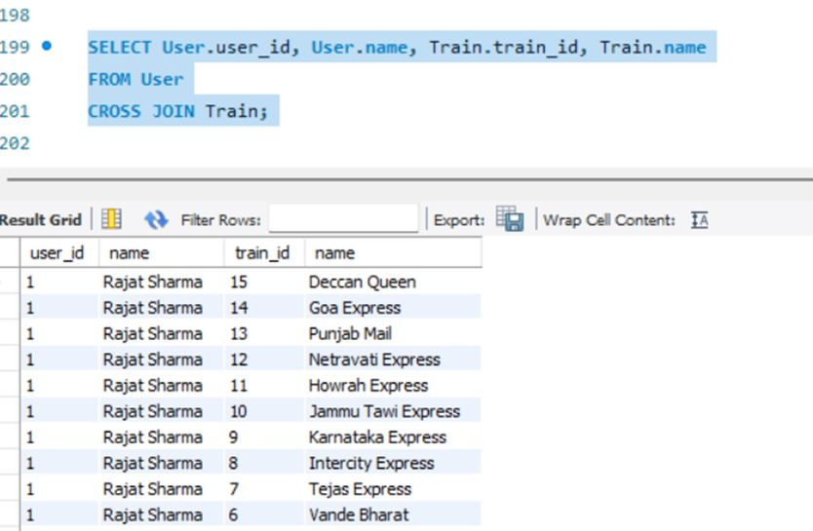
Using Joins
Find All Combinations of Users and Trains

Slide 26
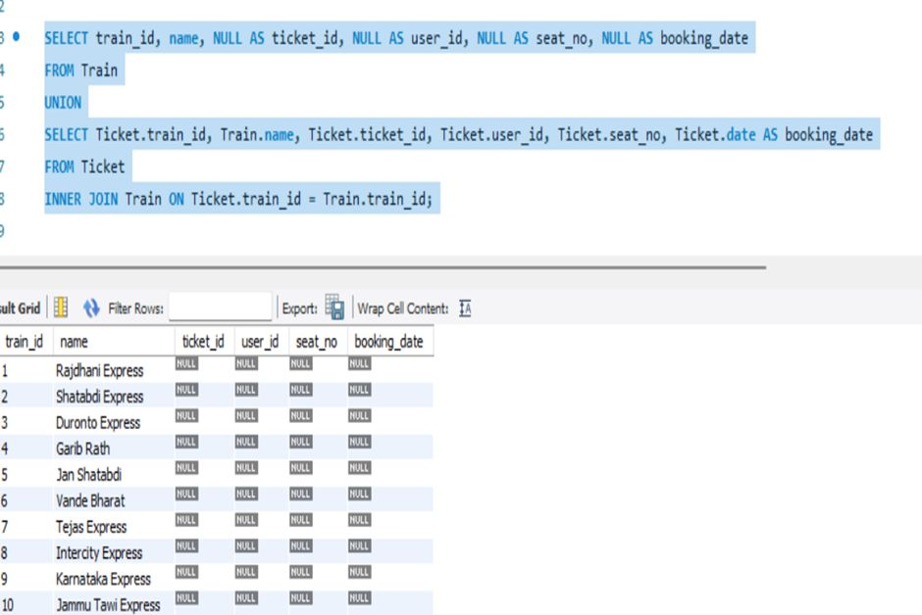
Using Joins
Union of Train Information and Ticket Booking

Slide 27
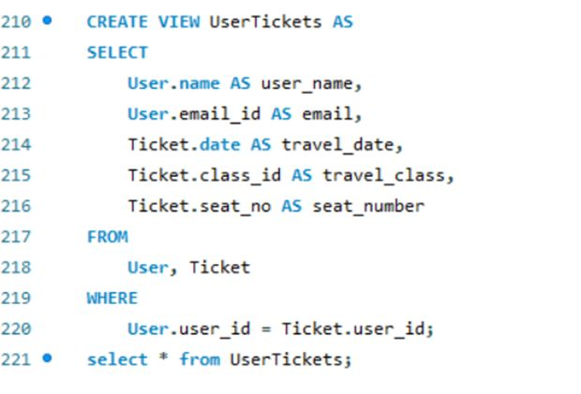
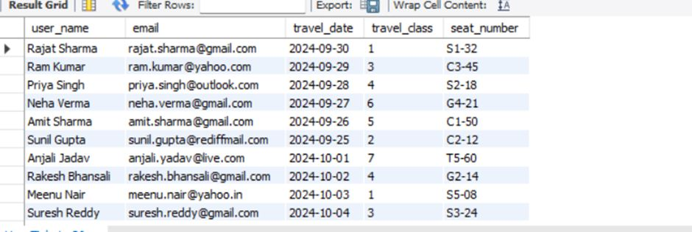
Creating Views
User Details with Booked Tickets

Slide 28
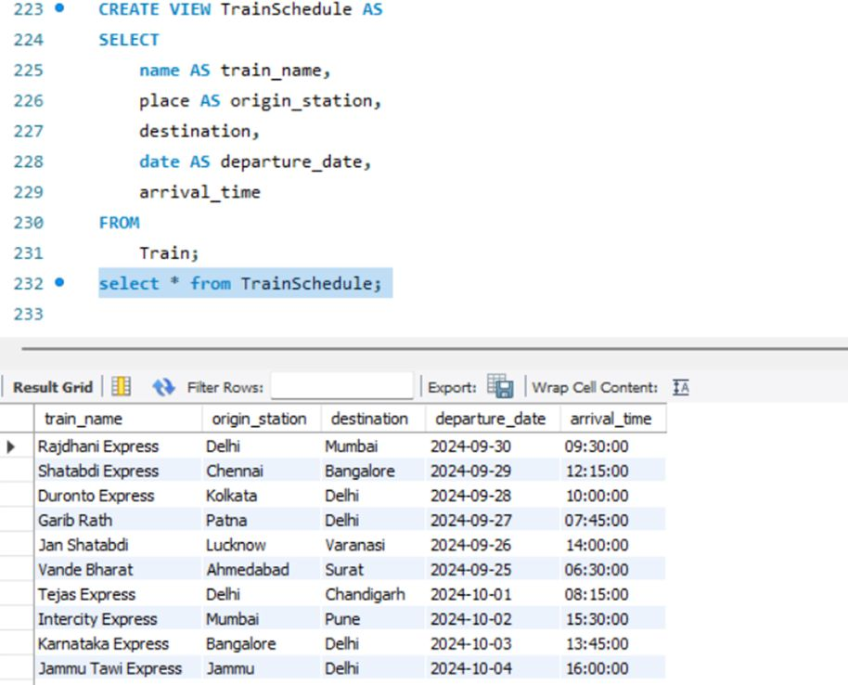
Creating Views
Train Schedule

Slide 29
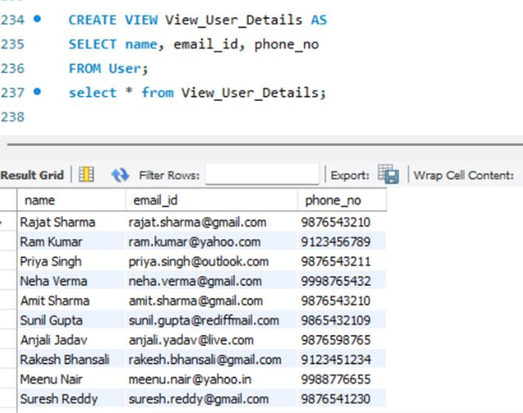
Creating Views
User Details

Slide 30
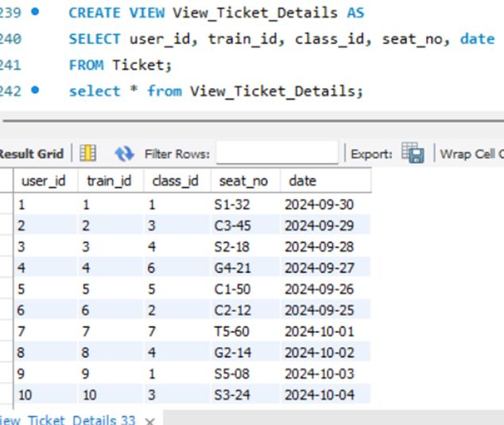
Creating Views
Ticket Details

Slide 31
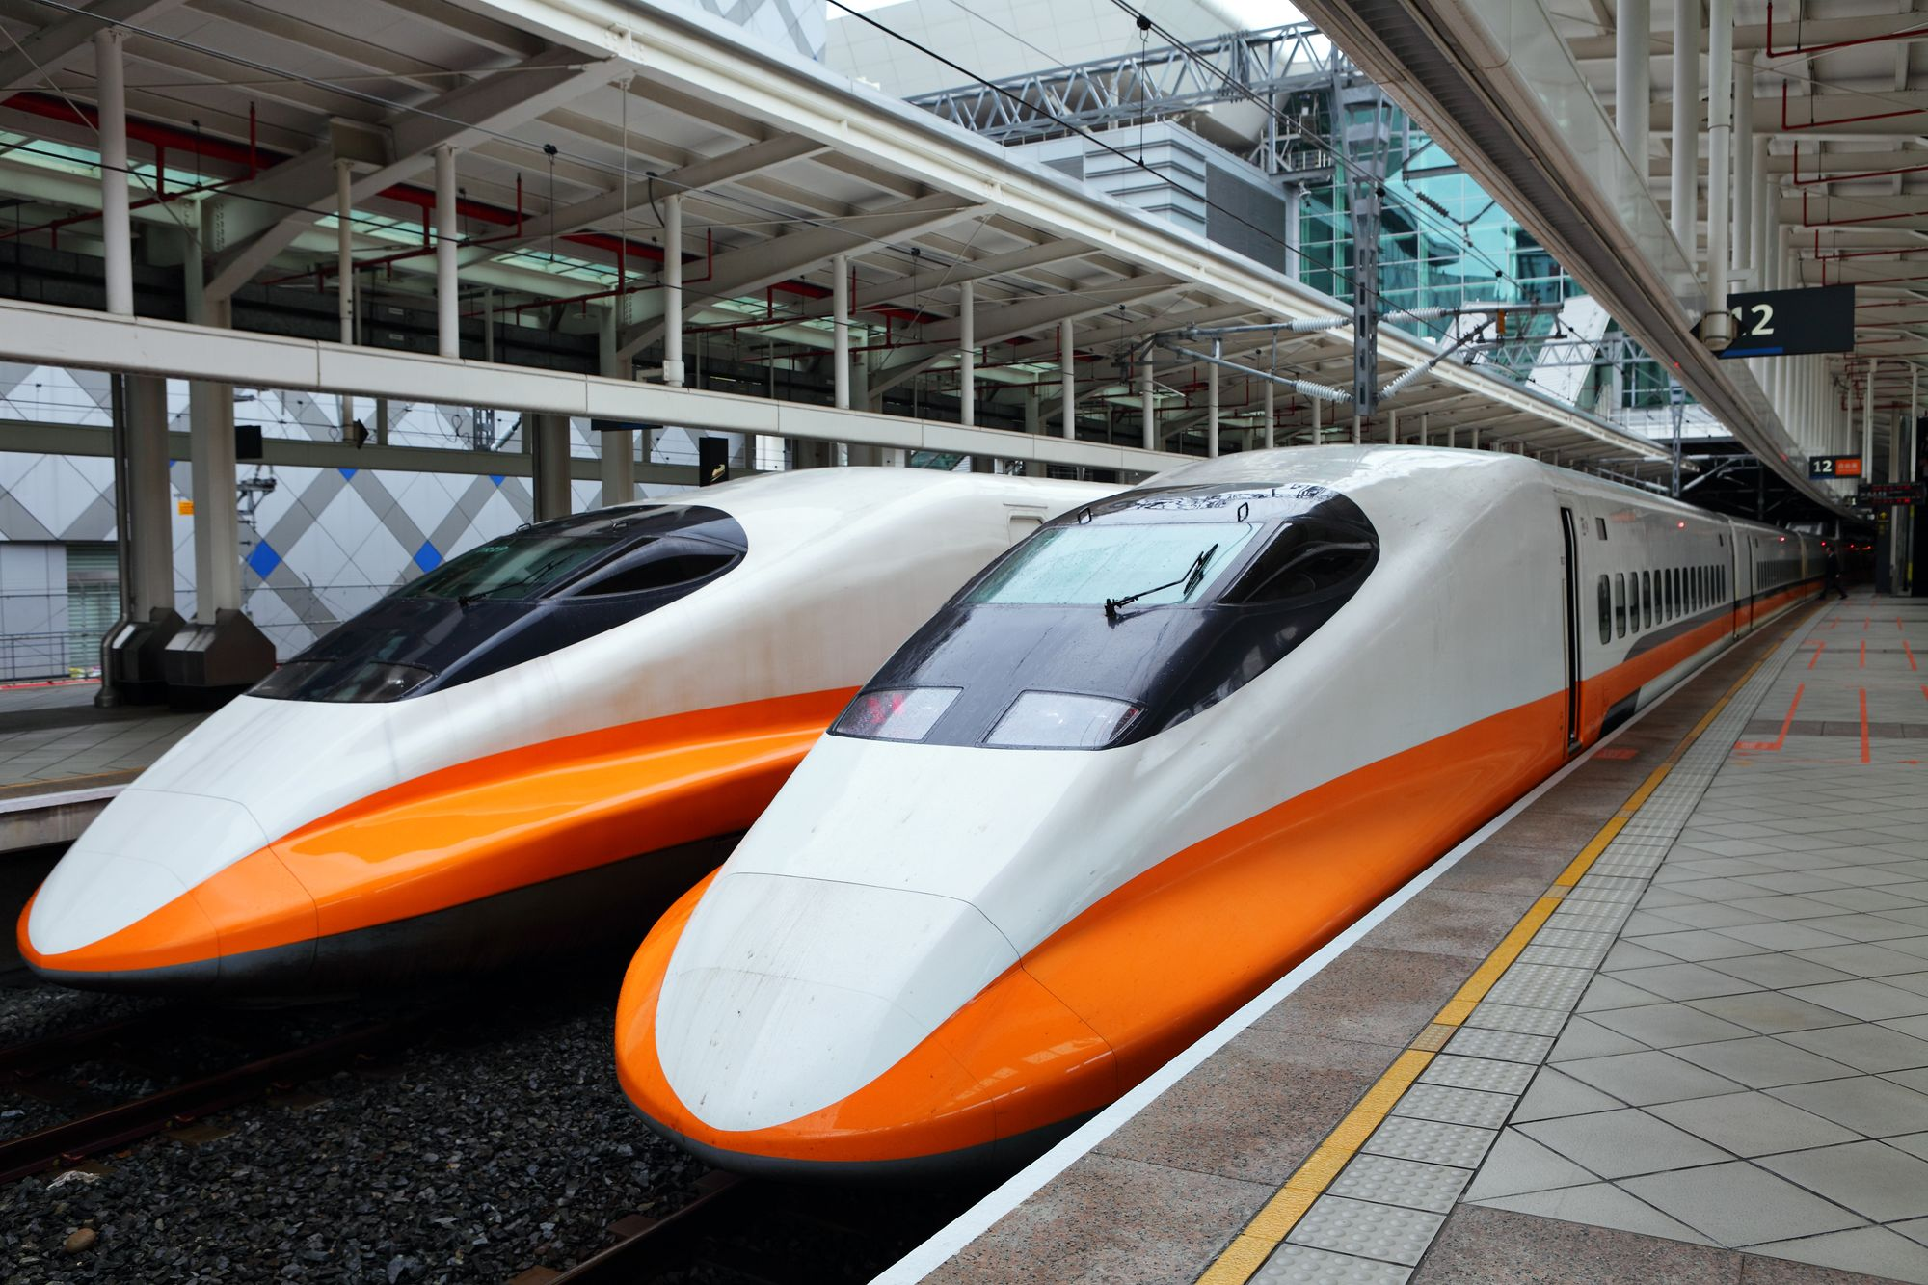
Safe travels!!!

